Slide 1
ChatPI - Team 7
Austin Rhodes, Alexis Tochiki, Aaron Daniels
The Sign of the Four
English to Spanish to English

Slide 2
QA Pipeline: Context + Question = answer
Directive from Assignment:
Use 300 words of context to answer questions related to the following
introducing the protagonist(s)
the antagonist
the crime and crime scene
any significant evidence
the resolution of the crime/a narrative that presents the case against the perpetrator
Questions:
Who is the investigator?
What was Jonathan Smalls role?
What was the main piece of evidence?
What was the murder weapon?
What did the crime scene look like?

Slide 3

Preprocessing
Context
Q/A answers
? =
Known answers
300 word sections
Q/A Pipeline
Context
Correct?

Slide 4
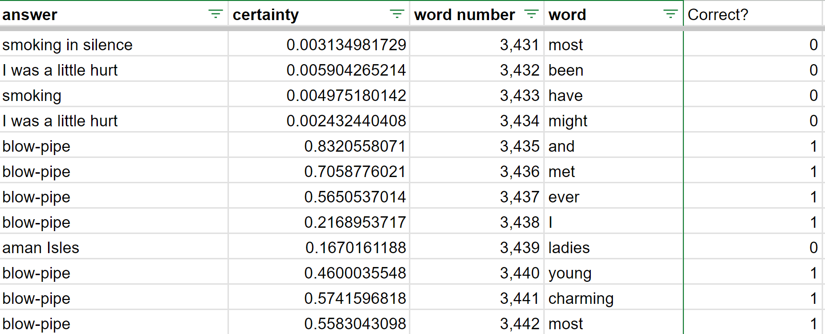
Grading correct/incorrect answers

Slide 5
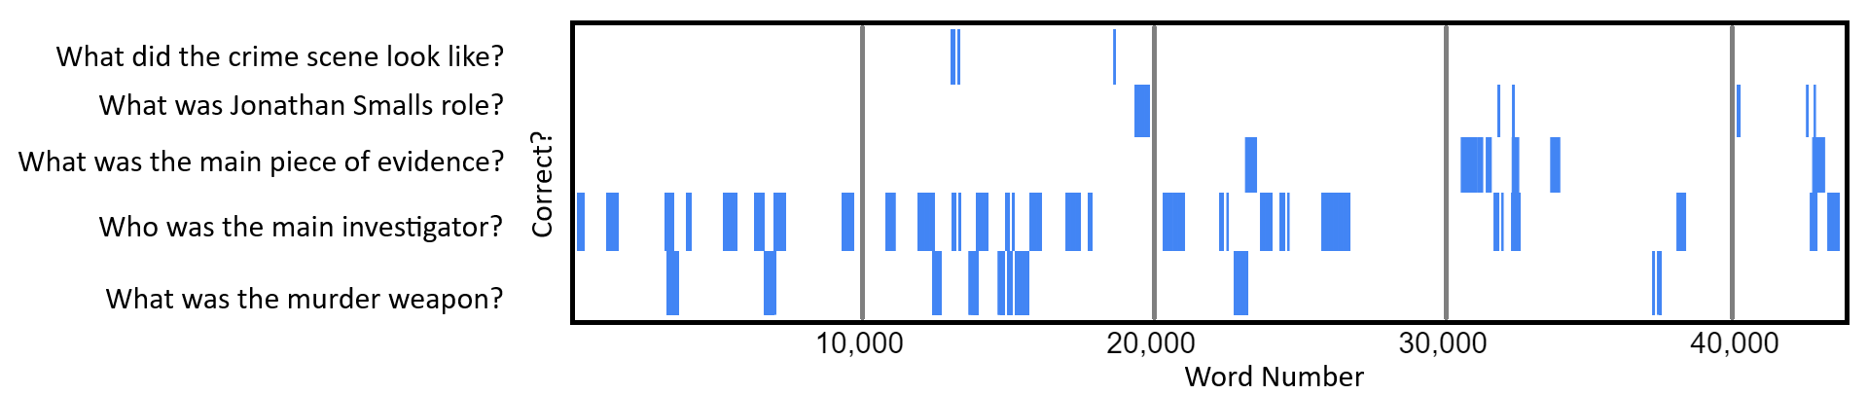
Map of Correct responses

Slide 6
Question Answering - Context Builder
Selecting contexts has huge impact on quality
Throwing in all 5 contexts had worse performance
Use regex to identify ‘tags’ in contexts and only select those
Context | Tags
Culprit | murder, suspect, culprit, criminal, villain, antagonist, killed
Evidence | murder, weapon, kill
Investigator | detective, investigator, protagonist
Crime Scene | crime, crime scene, evidence, clue
Suspect | accomplice, suspect, involve, treasure

Slide 7
Question Answering - Results
Context builder greatly improved accuracy
Regular vs Distilled model showed no discernable loss in quality, identical accuracy scores, but distilled had faster runtime
Models compared:
  deepset/roberta-base-squad2
  deepset/tinyroberta-squad2
Trial | Accuracy
Context Builder | 81.25%
All 5 contexts | 37.50%
Trial | Runtime
Standard | 63 seconds
Distilled | 37 seconds

Slide 8
Question Answering - Post-processing
Simple post-processing is used to make answers sound more realistic:
Question | Response | Score | Final Answer
“Who is the investigator?” | Sherlock Holmes | 0.894 | “Sherlock Holmes, I’m sure of it”
“What killed Sholto?” | poisoned darts | 0.159 | “I think it’s poisoned darts, but it’s hard to say”

Slide 9
Translation
Language: Spanish
Models used
  EN to ES: Helsinki-NLP/opus-mt-en-es, mrm8488/mbart-large-finetuned-opus-en-es-translation
  ES to EN: Helsinki-NLP/opus-mt-es-en, Helsinki-NLP/opus-mt-ROMANCE-en
Sherlock Holmes | Sherlock Holmes | Sherlock Holmes | Sherlock Holmes
the scientific detective | el detective científico | the scientific detective | the scientific detective
ten o’clock | a las diez en punto | at ten o'clock. | at 10 a.m.
One tiny speck of blood | Una pequeña mancha de sangre | A little blood stain | A small spot of blood
opposite to the iron box | frente a la caja de hierro | in front of the iron box | in front of the iron box
lowered the treasure-box to the ground | bajó la caja del tesoro al suelo | He lowered the treasure box to the ground. | The treasure box went down to the ground.
Notes:
Observations
-Shorter answers translated the same
-Translations did not give different answers

Slide 10
Summarization
Models used
  Default
  Pegasus
Context | Default Model | Pegasus Model
evidence | correct | correct
crime scene | correct | correct
investigator | correct | incorrect
Culprit | correct | correct
suspect | correct | correct

